Slide 1
Parallel Computing

Slide 2
COURSE CONTENT
FOUNDATION
SHARED MEMORY PROGRAMMING – OpenMP
DISTRIBUTED MEMORY PROGRAMMING – MPI

Slide 3
Who Is Using Parallel Computing?- Science and Engineering
Atmosphere, Earth, Environment
Physics - applied, nuclear, particle, condensed matter, high pressure, fusion, photonics
Bioscience, Biotechnology, Genetics
Chemistry, Molecular Sciences
Geology, Seismology
Mechanical Engineering - from prosthetics to spacecraft
Electrical Engineering, Circuit Design, Microelectronics
Computer Science, Mathematics
Defense, Weapons

Slide 4
Who Is Using Parallel Computing?- Industrial and Commercial
"Big Data," databases, data mining
Artificial Intelligence (AI)
Oil exploration
Web search engines, web based business services
Medical imaging and diagnosis
Pharmaceutical design
Financial and economic modeling
Management of national and multi-national corporations
Advanced graphics and virtual reality, particularly in the entertainment industry
Networked video and multi-media technologies
Collaborative work environments

Slide 5
Parallel cOMPUTING
Parallel computing is a type of computing architecture in which several processors execute or process an application or computation simultaneously.
Parallel computing helps in performing large computations by dividing the workload between more than one processor, all of which work through the computation at the same time.

Slide 6
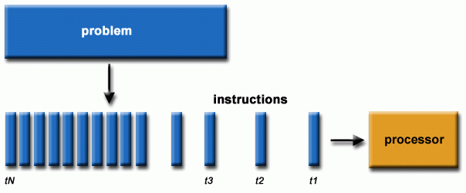

Slide 7
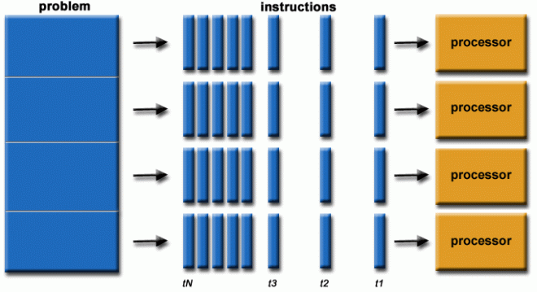

Slide 8
Why - every computer is a parallel computer
Nowadays all computers are essentially parallel.
Every operating computer there always exist various activities which
run in parallel, at the same time.
Parallel activities may arise and come to an end independently of each other
Parallel activities may be created purposely to involve simultaneous performance of various operations whose interplay will eventually lead to the desired result.
Parallelism is the existence of parallel activities within a computer and their use in achieving a common goal.

Slide 9
Parallelism is found on all levels of a modern computer’s architecture
First, parallelism is present deep in the processor microarchitecture.
Earlier processors ran programs by repeating the so-called instruction cycle, a sequence of four steps:
reading and decoding an instruction
finding data needed to process the instruction;
processing the instruction
writing the result

Slide 10
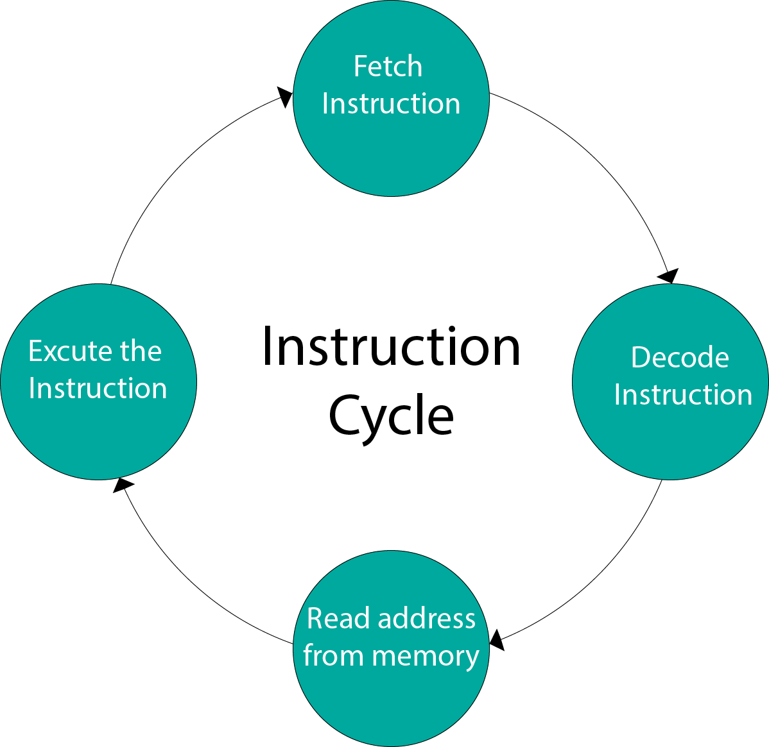

Slide 11
1st levels of a modern computer’s architecture
Design of a processor capable of execution of several instructions simultaneously.
Processor working is enabled detection and exploitation of parallelism inherent in instruction execution.
Instruction-level parallelism (ILP) is a measure of how many of the instructions in a computer program can be executed simultaneously.
Processors are allowed even higher execution speeds of programs, regardless of the processor and memory frequency.

Slide 12
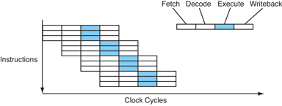
Pipe-lining

Slide 13
2nd levels of a modern computer’s architecture
Commercial computer, tablet and smartphone contains a processor with multiple cores
each of which is capable of running its own instruction stream.
Cores collaborate in running an application,
Application is run in parallel and may be considerably sped up.

Slide 14
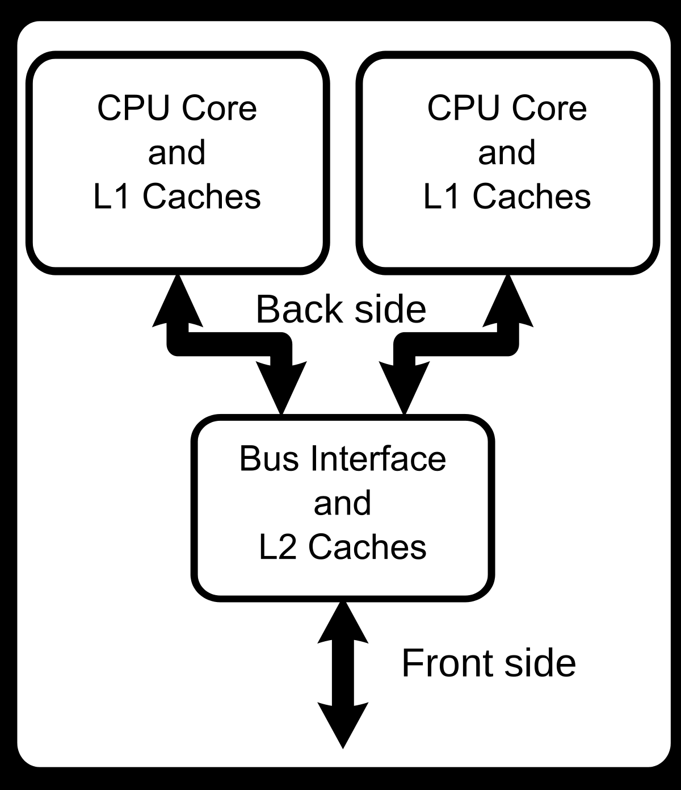

Slide 15
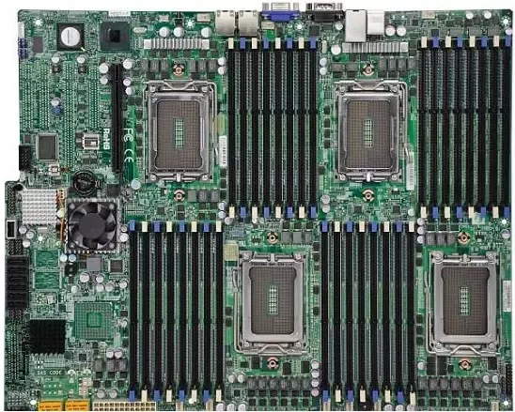
3rd levels of a modern computer’s architecture
Servers contain a several multicore processors.
Server is capable of running a service in parallel, and also several services in parallel.

Slide 16
3rd levels of a modern computer’s architecture
Consumer level computers contain graphic processors capable of running hundreds or even thousands of threads in parallel.
Processors capable of coping with such a large parallelism are necessary to support graphic animation.

Slide 17
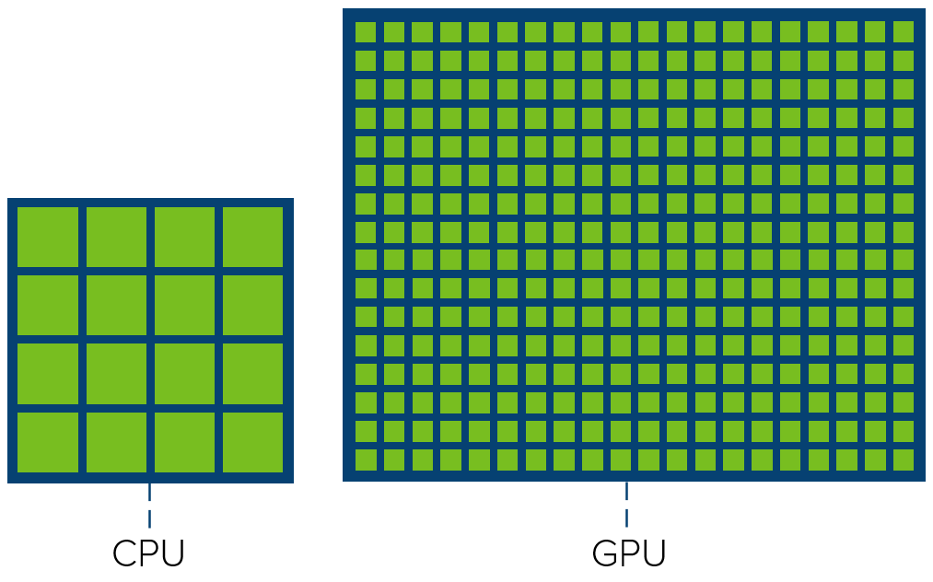

Slide 18
Reasons for making modern computers parallel
It is not possible to increase processor and memory frequencies indefinitely
at least not with the current silicon-based technology
Power consumption rises with processor frequency while the energy efficiency decreases.
Parallelism has become a part of any computer and this is likely to remain unchanged due to simple inertia

Slide 19
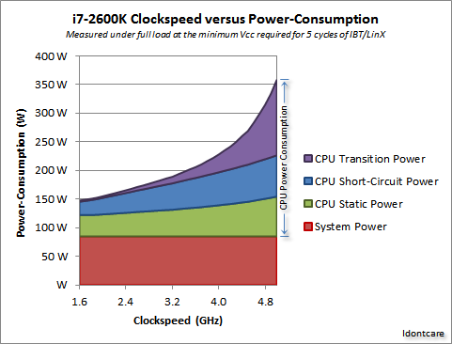

Slide 20

https://www.youtube.com/watch?v=XZmGGAbHqa0

Slide 21
Top Super Computer – June 2020
Frontier - HPE Cray EX235a, AMD Optimized 3rd Generation EPYC 64C 2GHz, AMD Instinct MI250X, Slingshot-11, HPE DOE/SC/Oak Ridge National Laboratory, United States
Cores -8,699,904
R-Max -1,194.00 PFlops/sec
Power -22,703 KW

Slide 22
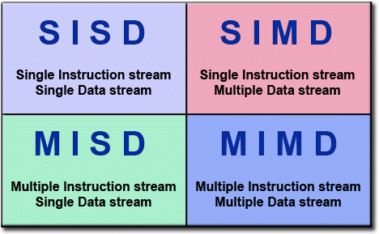
Flynn's Classical Taxonomy

Slide 23
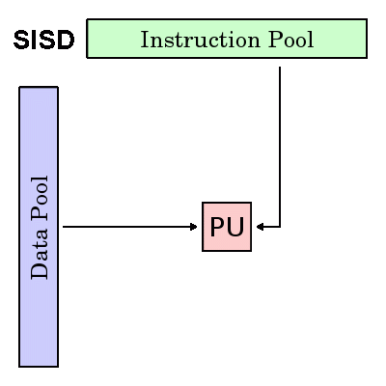
Single Instruction, Single Data (SISD)
Serial (non-parallel) computer
Single Instruction: Only one instruction stream is being acted on by the CPU during any one clock cycle
Single Data: Only one data stream is being used as input during any one clock cycle

Slide 24
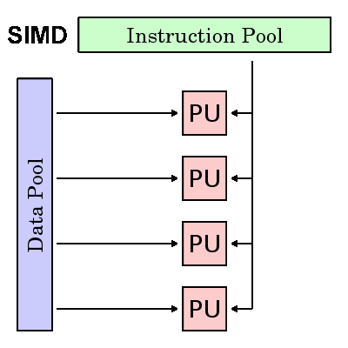
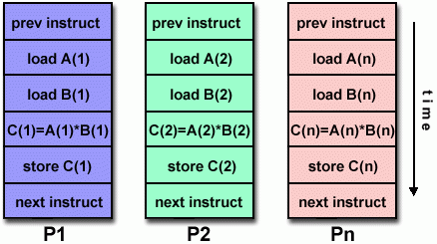
Single Instruction, Multiple Data (SIMD)

Slide 25
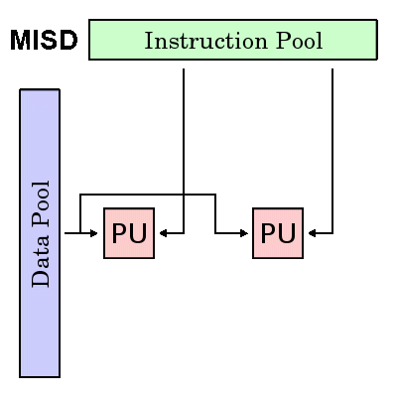
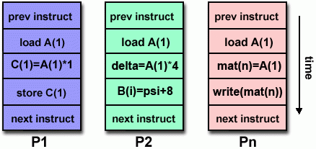
Multiple Instruction, Single Data (MISD)

Slide 26
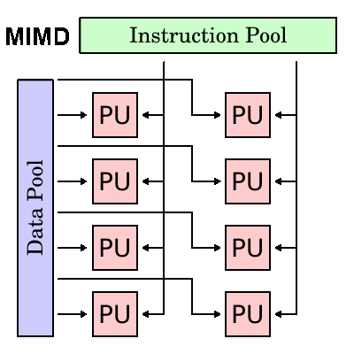
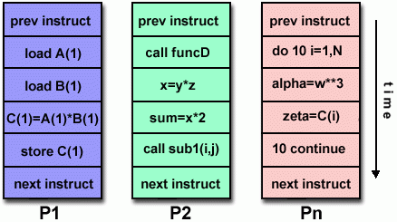
Multiple Instruction, Multiple Data (MIMD)

Slide 27
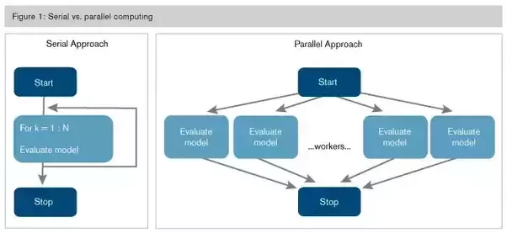

Slide 28
General Parallel Computing Terminology
CPU -Contemporary CPUs consist of one or more cores
Node -Standalone "computer in a box." Usually comprised of multiple CPUs/processors/cores, memory, network interfaces, etc. Nodes are networked together to comprise a supercomputer.
Task –Logically discrete section of computational work. A task is typically a program or program-like set of instructions that is executed by a processor. A parallel program consists of multiple tasks running on multiple processors.
Shared Memory- All processors have direct access to common physical memory

Slide 29
General Parallel Computing Terminology
Symmetric Multi-Processor (SMP) -Shared memory hardware architecture where multiple processors share a single address space and have equal access to all resources - memory, disk, etc.
Distributed Memory -Network based memory access for physical memory that is not common. As a programming model, tasks can only logically "see" local machine memory and must use communications to access memory on other machines where other tasks are executing.
Communications -Parallel tasks typically need to exchange data. There are several ways this can be accomplished, such as through a shared memory bus or over a network.

Slide 30
General Parallel Computing Terminology
Synchronization -The coordination of parallel tasks in real time, very often associated with communications. Synchronization usually involves waiting by at least one task, and can therefore cause a parallel application's wall clock execution time to increase.
Computational Granularity -In parallel computing, granularity is a quantitative or qualitative measure of the ratio of computation to communication.
Coarse: relatively large amounts of computational work are done between communication events
Fine: relatively small amounts of computational work are done between communication events

Slide 31
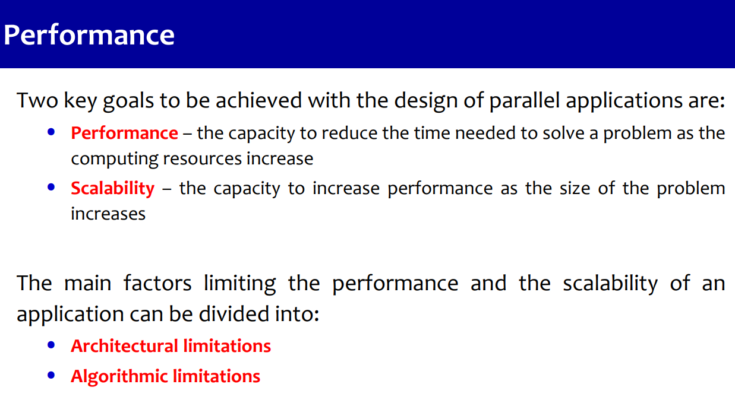

Slide 32
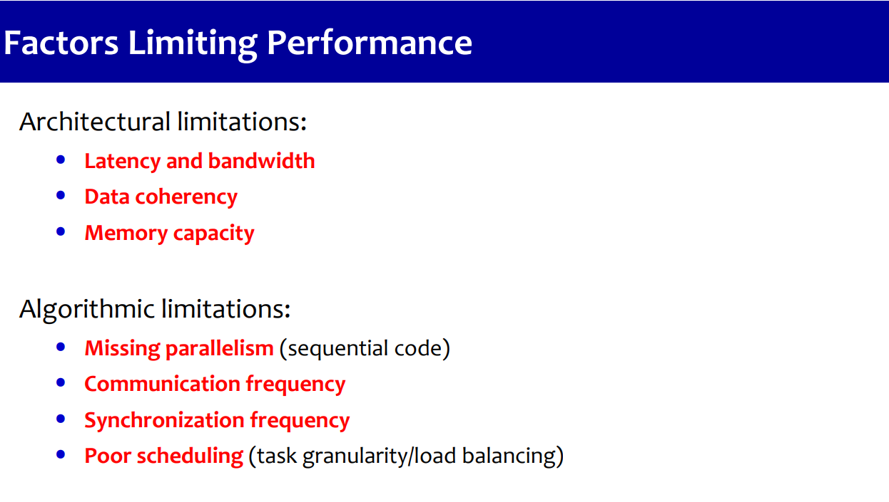

Slide 33
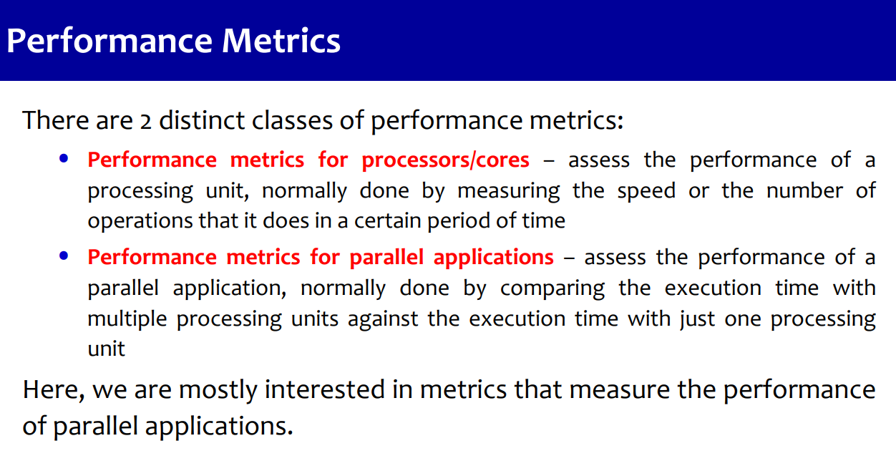

Slide 34
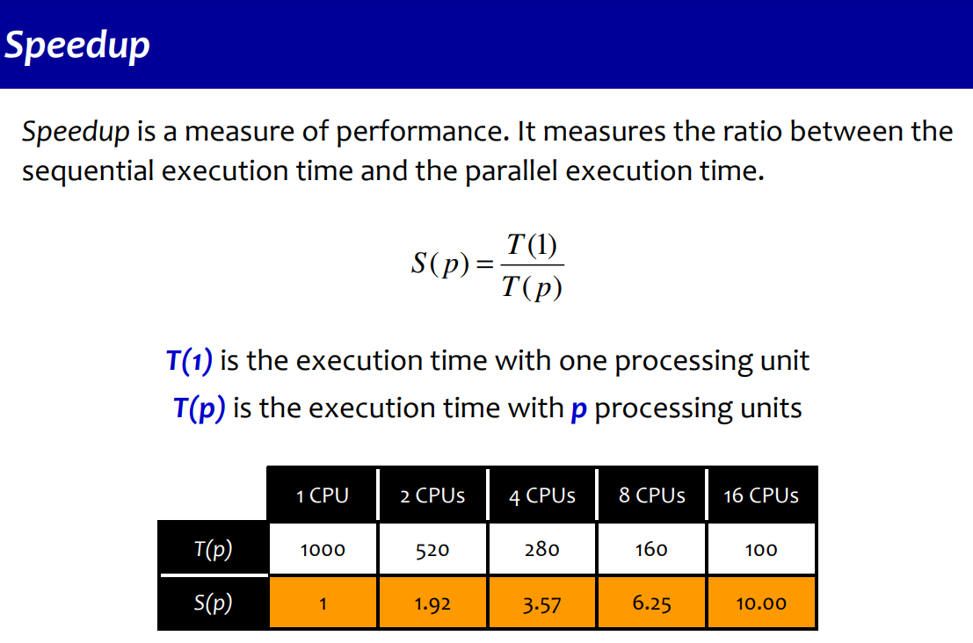

Slide 35
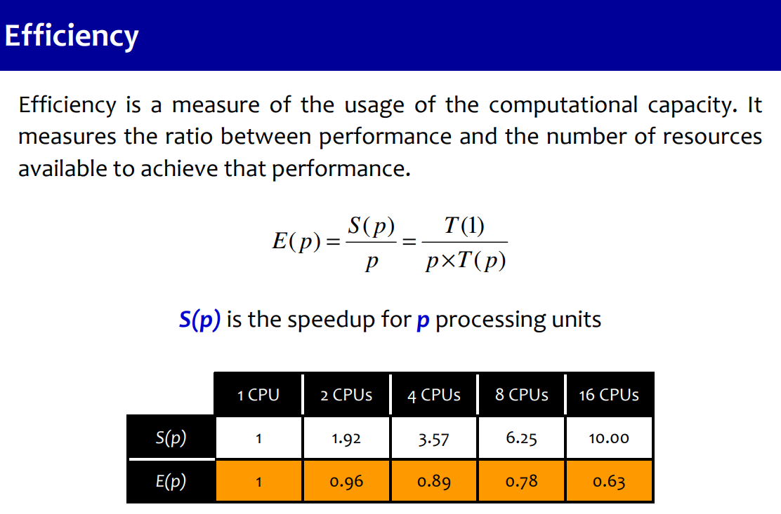

Slide 36
Performance
Tpar <= Tseq <=p .Tpar
Speedup and efficiency are bounded by
E <= 1:
For any C and p, the parallel execution of P on C(p) can be at most p times faster than the execution of P on a single processor.
Efficiency of the parallel execution of P on C(p) can be at most 1.

Slide 37
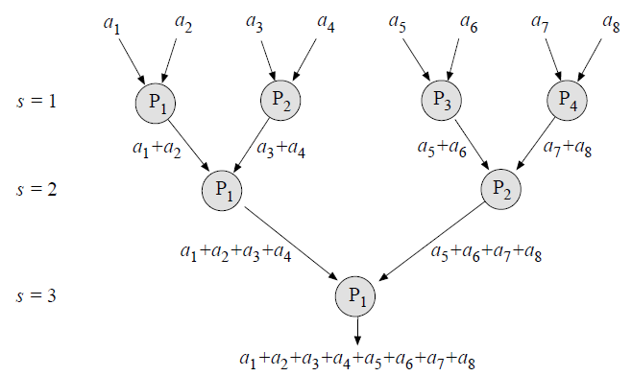

Slide 38
Introduction
Types of parallel machines
distributed memory
each processor has its own memory address space
variable values are independent
x = 2 on one processor, x = 3 on a different processor
examples: linux clusters, Blue Gene/L
shared memory
also called Symmetric Multiprocessing (SMP)
single address space for all processors
If one processor sets x = 2 , x will also equal 2 on other processors (unless specified otherwise)
examples: IBM p-series, SGI Altix

Slide 39
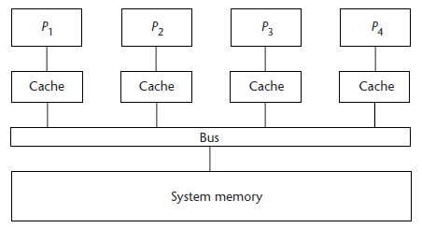
Types of parallelism
Shared memory systems
Systems with multiple processing units attached to a single memory.

Slide 40
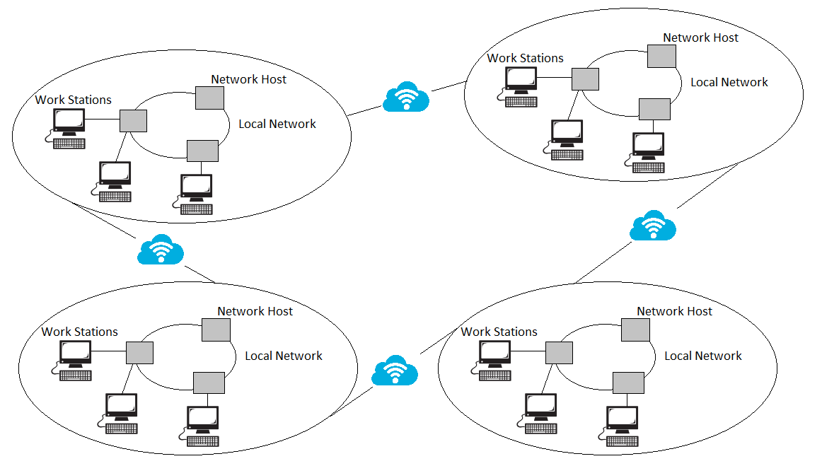
Types of parallelism
Distributed systems
Systems consisting of many computer units
Each with its own processing unit and its physical memory
That are connected with fast interconnection networks.

Slide 41
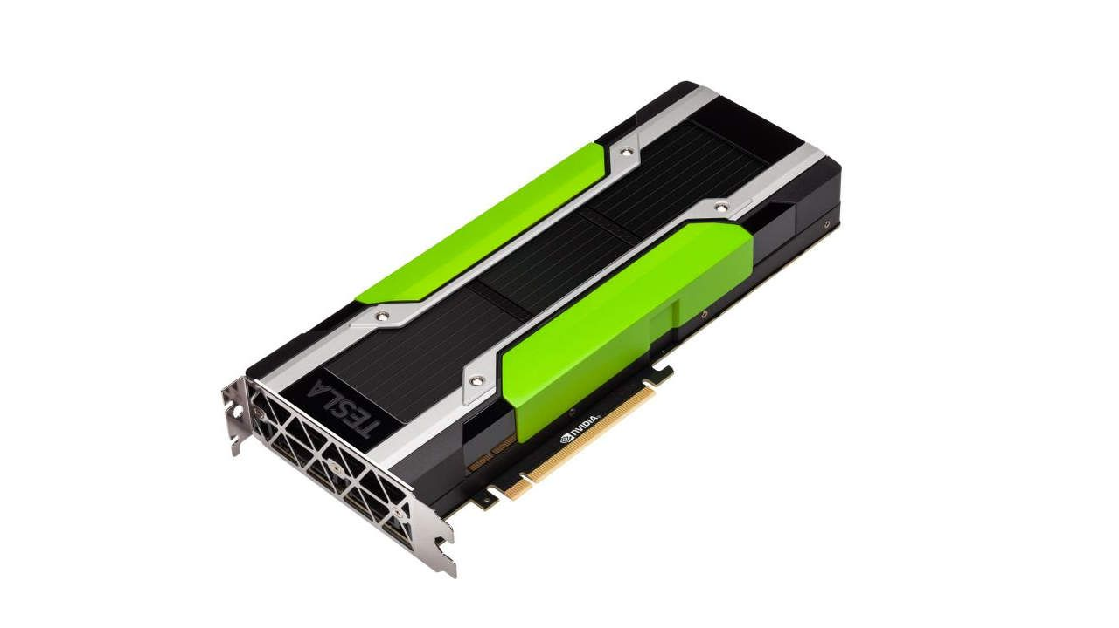
Types of parallelism
Graphic processor units
Co-processors for solving general purpose numerically intensive problems.

Slide 42
Shared vs. Distributed Memory
CPU 0
CPU 1
CPU 2
CPU 3
CPU 0
CPU 1
CPU 2
CPU 3
MEM 0
MEM 1
MEM 2
MEM 3
MEM
distributed
shared

Slide 43
Clustered SMPs
Cluster Interconnect Network
Memory
Memory
Memory
Multi-socket and/or Multi-core

Slide 44
Shared vs. Distributed Memory (cont’d)
Multiple processes
Each processor (typically) performs independent task
Multiple threads
A process spawns additional tasks (threads) with same memory address space

Slide 45
Distributed vs. Shared Memory
Shared - all processors share a global pool of memory
simpler to program
bus contention leads to poor scalability
Distributed - each processor physically has it’s own (private) memory associated with it
scales well
memory management is more difficult

Slide 46
What is OpenMP?
Application Programming Interface (API) for multi-threaded parallelization consisting of
Source code directives
Functions
Environment variables

Slide 47
What is OpenMP? (cont’d)
Advantages
Easy to use
Incremental parallelization
Flexible
Loop-level or coarse-grain
Portable
Since there’s a standard, will work on any SMP machine
Disadvantage
Shared-memory systems only

Slide 48
Why choose OpenMP ?
Portable
standardized for shared memory architectures
Simple and Quick
incremental parallelization
supports both fine grained and coarse grained parallelism
scalable algorithms without message passing
Compact API
simple and limited set of directives

Slide 49
OpenMP - User Interface Model
Shared Memory with thread based parallelism
Not a new language
Compiler directives, library calls and environment variables extend the base language
f77, f90, f95, C, C++
Not automatic parallelization
user explicitly specifies parallel execution
compiler does not ignore user directives even if wrong

Slide 50
What is a thread?
Thread is an independent instruction stream, thus allowing concurrent operation
Threads tend to share state and memory information and may have some (usually small) private data
Similar (but distinct) from processes. Threads are usually lighter weight allowing faster context switching
in OpenMP one usually wants no more than one thread per core

Slide 51
Execution Model
OpenMP program starts single threaded
To create additional threads, user starts a parallel region
additional threads are launched to create a team
original (master) thread is part of the team
threads “go away” at the end of the parallel region: usually sleep or spin
Repeat parallel regions as necessary
Fork-join model

Slide 52
Communicating Between Threads
Shared Memory Model
threads read and write shared variables
no need for explicit message passing
use synchronization to protect against race conditions
change storage attributes for minimizing synchronization and improving cache reuse

Slide 53
Storage Model – Data Scoping
Shared memory programming model: variables are shared by default
Global variables are SHARED among threads
Fortran: COMMON blocks, SAVE variables, MODULE variables
C: file scope variables, static
Private Variables:
exist only within the new scope, i.e. they are uninitialized and undefined outside the data scope
loop index variables
Stack variables in sub-programs called from parallel regions

Slide 54
Basics
Goal – distribute work among threads
Two methods will be discussed here
Loop-level
Specified loops are parallelized
This is approach taken by automatic parallelization tools
Parallel regions
Sometimes called “coarse-grained”
Don’t know good term; good way to start argument with semantically precise people
Usually used in message-passing (MPI)

Slide 55
Basics (cont’d)
serial
loop
serial
loop
serial
Loop-level
Parallel regions

Slide 56
parallel do & parallel for
parallel do (Fortran) and parallel for (C) directives parallelize subsequent loop
Use “c$” for fixed-format Fortran
!$omp parallel do
do i = 1, maxi
a(i) = b(i) + c(i)
enddo
#pragma omp parallel for
for(i = 1; i <= maxi; i++){
a[i] = b[i] = c[i];
}

Slide 57
parallel do & parallel for (cont’d)
Suppose maxi = 1000
Thread 0 gets i = 1 to 250
Thread 1 gets i = 251 to 500
etc.
Barrier implied at end of loop

Slide 58
Creating Parallel Regions
Only one way to create threads in OpenMP API:
Fortran:
!$OMP parallel
< code to be executed in parallel >
!$OMP end parallel
C
#pragma omp parallel
{
code to be executed by each thread
}

Slide 59
Comparison of Programming Models
Feature | Open MP | MPI
Portable | yes | yes
Scalable | less so | yes
Incremental Parallelization | yes | no
Fortran/C/C++ Bindings | yes | yes
High Level | yes | mid level

Slide 60
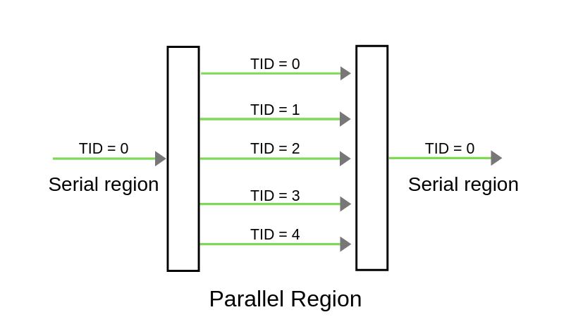

Slide 61
// OpenMP program to print Hello World
// using C language
// OpenMP header
#include <omp.h>
#include <stdio.h>
#include <stdlib.h>
int main(int argc, char* argv[])
{
// Beginning of parallel region
#pragma omp parallel
{
printf("Hello World... from thread = %d\n",
omp_get_thread_num());
}
// Ending of parallel region
}

Slide 62



Compiling
Intel (icc, ifort, icpc)
-openmp
PGI (pgcc, pgf90, …)
-mp
GNU (gcc, gfortran, g++)
-fopenmp
need version 4.2 or later
g95 was based on GCC but branched off
I don’t think it has Open MP support
gcc –fopenmp –o hello hello.c

Slide 63
Specifying threads
The simplest way to specify the number of threads used on a parallel region is to set the environment variable (in the shell where the program is executing)
OMP_NUM_THREADS
For example, in csh/tcsh
setenv OMP_NUM_THREADS 4
in bash
export OMP_NUM_THREADS=4
Later we will cover other ways to specify this

Slide 64
Using OpenMP to write multithreaded programs
Parallel program running on a shared memory multiprocessor usually consists of multiple threads.
The number of threads may vary during program execution but at any time each thread is being executed on one logical core.
If there are less threads than logical cores, some logical cores are kept idle and the system is not fully utilized.
If there are more threads than logical cores, the operating system applies multitasking among threads running on the same logical cores.
During program execution the operating system may perform load balancing,
i.e., it may migrate threads from one logical core to another in an attempt to keep all logical cores equally utilized.

Slide 65
Using OpenMP to write multithreaded programs
A multithreaded program can be written in different programming languages using many different libraries and frameworks.
On UNIX, for instance, one can use pthreads in almost any decent programming language
Resulting program is littered with low-level details that the compiler could have taken care of, and is not portable.
One such thing is OpenMP, a parallel programming environment best suitable for writing parallel programs that are to be run on shared memory systems.
It is not yet another programming language but an add-on to an existing language, usually Fortran or C/C++.

Slide 66
Using OpenMP to write multithreaded programs
Application programming interface (API) of OpenMP is a collection of
compiler directives,
supporting functions,
shell variables.
OpenMP compiler directives tell the compiler about the parallelism in the source code and provide instructions for generating the parallel code
i.e., the multithreaded translation of the source code.
In C/C++, directives are always expressed as #pragmas.
Supporting functions enable programmers to exploit and control the parallelism during the execution of a program.
Shell variables permit tunning of compiled programs to a particular parallel system.

Slide 67
Compiling and running an OpenMP program
#include <stdio .h>
#include <omp.h>
int main () {
printf ("Hello , world :");
# pragma omp parallel
printf (" %d", omp_get_thread_num ());
printf ("\n");
return 0;
}

Slide 68
Compiling and running an OpenMP program
This program starts as a single thread that first prints out the salutation.
Once the execution reaches the omp parallel directive, several additional threads are created alongside the existing one.
All threads, the initial thread and the newly created threads, together form a team of threads.
Each thread in the newly established team of threads executes the statement immediately following the directive:
in this example it just prints out its unique thread number obtained by calling OpenMP function omp_get_thread_num.
When all threads have done that, threads created by the omp parallel directive are terminated

Slide 69
Compiling and running an OpenMP program
To compile and run the program using GNU GCC C/C++ compiler, use the command-line option -fopenmp
$ gcc -fopenmp -o hello-world hello-world.c
$ env OMP_NUM_THREADS=8 ./hello-world

Slide 70
OpenMP: parallel regions
A parallel region within a program is specified as
#pragma omp parallel [clause [[,] clause] . . . ]
structured-block
A team of threads is formed and the thread that encountered the omp parallel directive becomes the master thread within this team.
The structured-block is executed by every thread in the team.
It is either a single statement, possibly compound, with a single entry at the top and a single exit at the bottom, or another OpenMP construct.
At the end there is an implicit barrier, i.e., only after all threads have finished, the threads created by this directive are terminated and only the master resumes execution.
A parallel region might be refined by a list of clauses, for instance
num_threads(integer) specifies the number of threads that should execute structured-block in parallel.

Slide 71
OpenMP: controlling the number of threads
Once a program is compiled, the number of threads can be controlled using the following shell variables:
OMP_NUM_THREADS comma-separated-list-of-positive-integers
The first one sets the number of threads the program should use
or how many threads should be used at every nested level of parallel execution
OMP_THREAD_LIMIT positive-integer
limits the number of threads a program can use and takes the precedence over OMP_NUM_THREADS.

Slide 72
OpenMP: controlling the number of threads
Within a program, the following functions can be used to control the number of threads:
void omp_set_num_threads() sets the number of threads used in the subsequent parallel regions without explicit specification of the number of threads;
int omp_get_num_threads() returns the number of threads in the current team relating to the innermost enclosing parallel region;
int omp_get_max_threads() returns the maximal number of threads available to the subsequent parallel regions;
int omp_get_thread_num() returns the thread number of the calling thread within the current team of threads.

Slide 73
Monitoring an OpenMP program
To understand how an OpenMP program actually runs on a multi-core system
it is best to monitor and measure the performance of the program.
Even more, this is the simplest and the most reliable way to know how many cores your program actually runs on.
The program starts several threads, each of them printing out one Fibonacci number computed using the naïve and time-consuming recursive algorithm.

Slide 74
Monitoring an OpenMP program
# include <stdio .h>
# include <omp.h>
long fib (int n) { return (n < 2 ? 1 : fib (n - 1) + fib (n - 2)); }
int main () {
int n = 45;
# pragma omp parallel
{
int t = omp_get_thread_num ();
printf ("%d: %ld\n", t, fib (n + t));
}
return 0;
}
$ env OMP_NUM_THREADS=8 time ./fibonacci

Slide 75
Monitoring an OpenMP program
106.46 real 298.45 user 0.29 sys
User and system time amount to the total time that all logical cores together spent executing the program.
In the example above, the sum of the user and system time is bigger than the real time, i.e., the elapsed or wall-clock time.
Hence, various parts of the program must have run on several logical cores simultaneously.

Slide 76
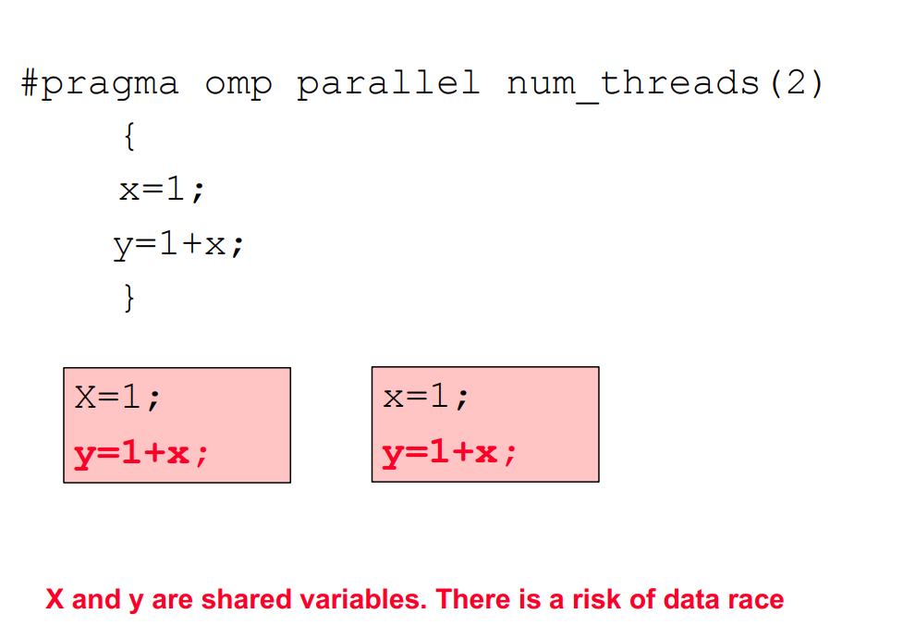

Slide 77
Monitoring an OpenMP program
Most operating systems provide system monitors that among other metrics show the amount of computation performed by individual cores.
most system monitor reports the overall load on an individual logical core, i.e., load of all programs running on a logical core.
Using a system monitor while the program is run on idle system, one can observe the load on individual logical cores during program execution.
As threads finish one after another, one can observe how the load on individual logical cores drops as the execution proceeds.
Towards the end of execution, with only one thread remaining, it can be seen how the operating system occasionally migrates the last thread from one logical core to another.

Slide 78
Parallelization of loops
Most CPU-intensive programs for solving scientific or technical problems spend most of their time running loops
OpenMP provides for the efficient and portable implementation of parallel loops.

Slide 79
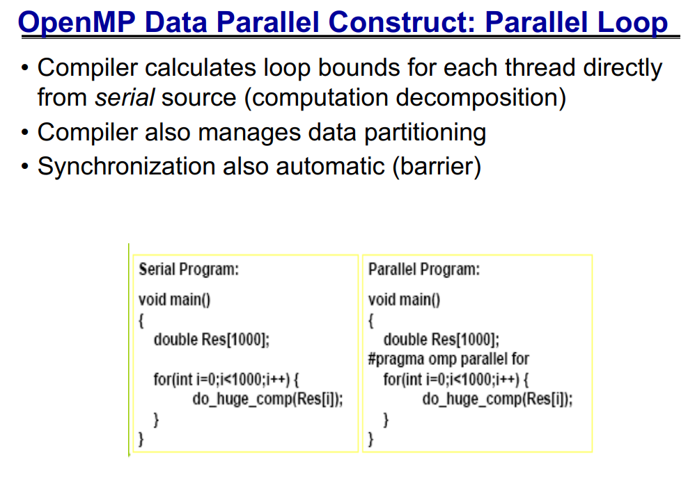

Slide 80
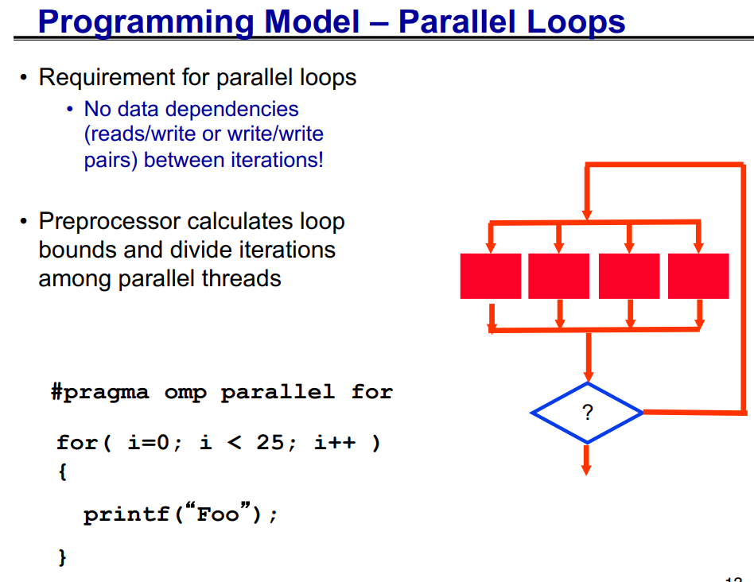

Slide 81
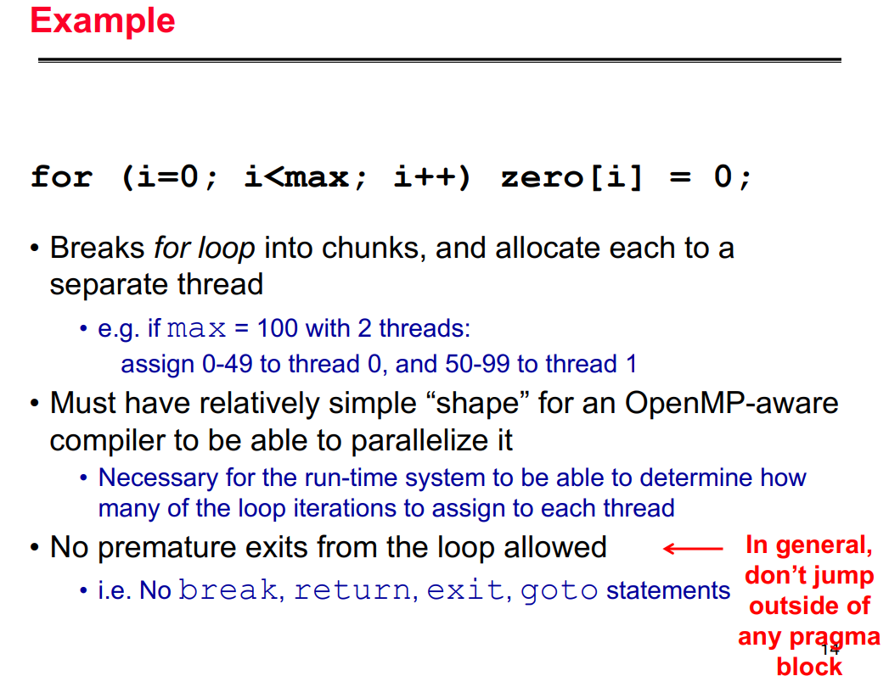

Slide 82
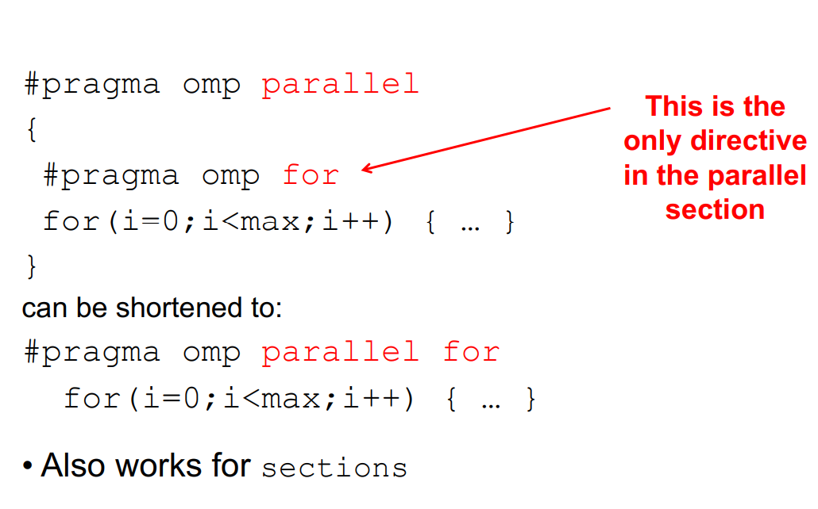

Slide 83
Parallelizing loops with independent iterations
. Printing out all integers from 1 to max in no particular order.
#include <stdio .h>
# include <omp.h>
int main ( int argc , char * argv []) {
int max;
sscanf ( argv [1] , "%d", &max );
# pragma omp parallel for
for ( int i = 1; i <= max; i++)
printf ("%d: %d\n", omp_get_thread_num () , i);
return 0;
}

Slide 84
Parallelizing loops with independent iterations
The program starts as a single initial thread.
The value max is read and stored in variable max.
The execution then reaches the most important part of the program, namely the for loop which actually prints out the numbers
omp parallel for directive in line 6 specifies that the for loop must be executed in parallel,
i.e., its iterations must be divided among and executed by multiple threads running on all available processing units.
Hence, a number of slave threads is created, one per each available processing unit or as specified explicitly
minus one that the initial thread runs on
The initial thread becomes the master thread and together with the newly created slave threads the team of threads is formed.

Slide 85
Parallelizing loops with independent iterations
iterations of the parallel for loop are divided among threads where each iteration is executed by the thread it has been assigned to
Once all iterations have been executed, all threads in the team are synchronized at the implicit barrier at the end of the parallel for loop and all slave threads are terminated.
Finally, the execution proceeds sequentially and the master thread terminates the program by executing return 0.

Slide 86
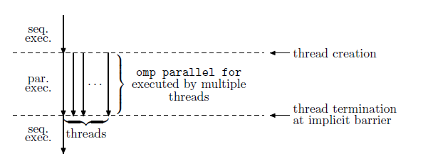
Parallelizing loops with independent iterations

Slide 87
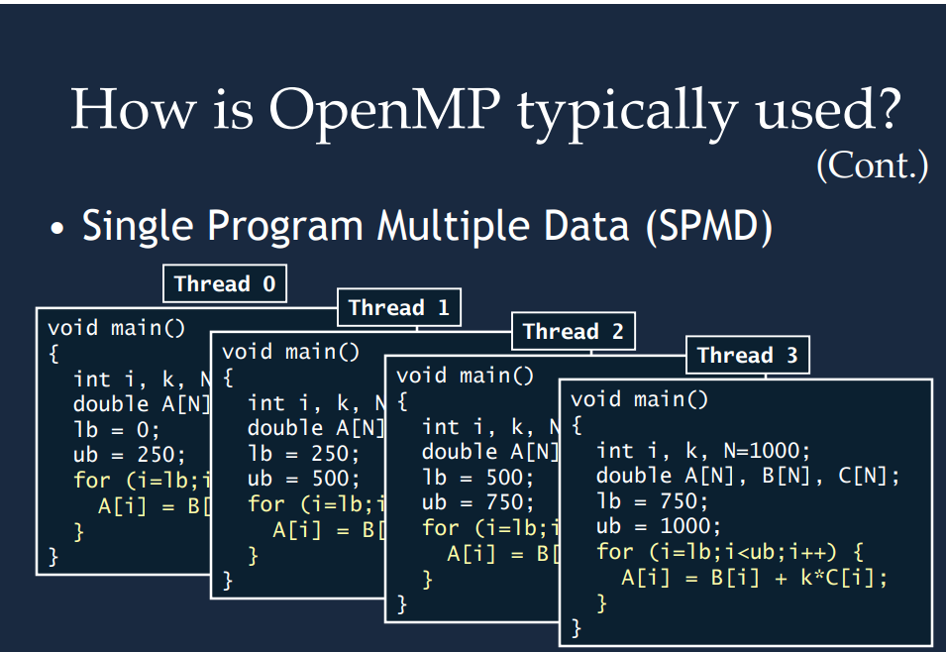

Slide 88
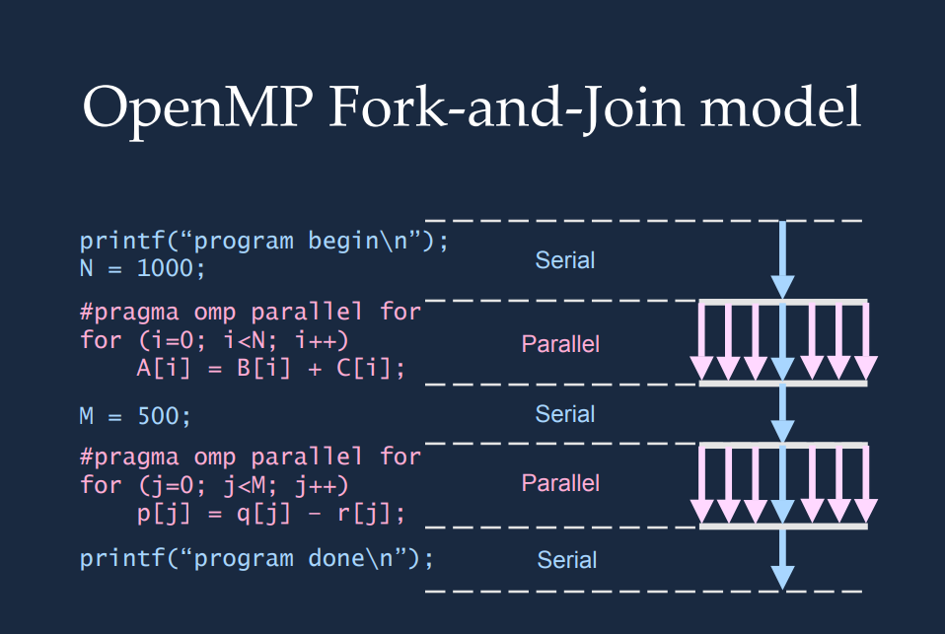

Slide 89
Parallelizing loops with independent iterations
Several observation must be made
First, the program does not specify how the iterations should be divided among threads
OpenMP implementations divide the entire iteration space into chunks where each chunk containing a subinterval of all iterations is executed by one thread.
Second, once the iteration space is divided into chunks, all iterations of an individual chunk are executed sequentially, one iteration after another.
Third, the parallel for loop variable i is made private in each thread executing a chunk of iterations as each thread must have its own copy of i.
Variable max can be shared by all threads as it is set before and is only read within the parallel region.

Slide 90
OpenMP: data sharing
Various data sharing clauses might be used in omp parallel directive to specify whether and how data are shared among threads:
shared(list) specifies that each variable in the list is shared by all threads in a team, i.e., all threads share the same copy of the variable;
private(list) specifies that each variable in the list is private to each thread in a team, i.e., each thread has its own local copy of the variable;
firstprivate(list) is like private but each variable listed is initialized with the value it contained when the parallel region was encountered;
lastprivate(list) is like private but when the parallel region ends each variable listed is updated with its final value within the parallel region.

Slide 91
OpenMP: data sharing
No variable listed in these clauses can be a part of another variable.
If not specified otherwise,
automatic variables declared outside a parallel construct are shared,
automatic variables declared within a parallel construct are private,
static and dynamically allocated variables are shared.
Race conditions
e.g., resulting from different life times of lastprivate variables or updating shared variables, must be avoided explicitly by using OpenMP constructs

Slide 92
#include <stdio.h>
#include <stdlib.h>
#include <omp.h>
int main(void){
int i;
int x;
x=44;
#pragma omp parallel for private(x)
for(i=0;i<=10;i++){
x=i;
printf("Thread number: %d x: %d\n",omp_get_thread_num(),x);
}
printf("x is %d\n", x);
}

Slide 93
Vector addition
double * vectAdd ( double *c, double *a, double *b, int n) {
# pragma omp parallel for
for ( int i = 0; i < n; i++)
c[i] = a[i] + b[i];
return c;
}

Slide 94
Vector addition
As vector addition is not a complex computation at all, use long vectors and perform a large number of vector additions to measure and monitor it.
Simple parallel for loop where the result of one iteration is completely independent of the results produced by other loops.
Different iterations access different array elements, i.e., they read from and write to completely different memory locations.

Slide 95
Printing out all pairs of integers from 1 to max
# include <stdio .h>
# include <omp.h>
int main ( int argc , char * argv []) {
int max; sscanf ( argv [1] , "%d", &max );
# pragma omp parallel for
for ( int i = 1; i <= max; i++)
for ( int j = 1; j <= max; j ++)
printf ("%d: (%d ,%d)\n", omp_get_thread_num () , i, j);
return 0;
}

Slide 96
Printing out all pairs of integers from 1 to max
As all iterations of both nested loops are independent, either loop can be parallelized while the other is not.
This is achieved by placing the omp parallel for directive in front of the loop targeted for parallelization
Assume all pairs of integers from 1 to max are arranged in a square table.
If 4 threads are used and max = 6, each iteration of the parallelized outer for loop prints out a few lines of the table

Slide 97
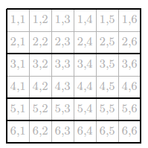
Printing out all pairs of integers from 1 to max
Note that the first two threads are assigned twice as much work than the other two threads which, if run on 4 logical cores, will have to wait idle until the first two complete as well.

Slide 98
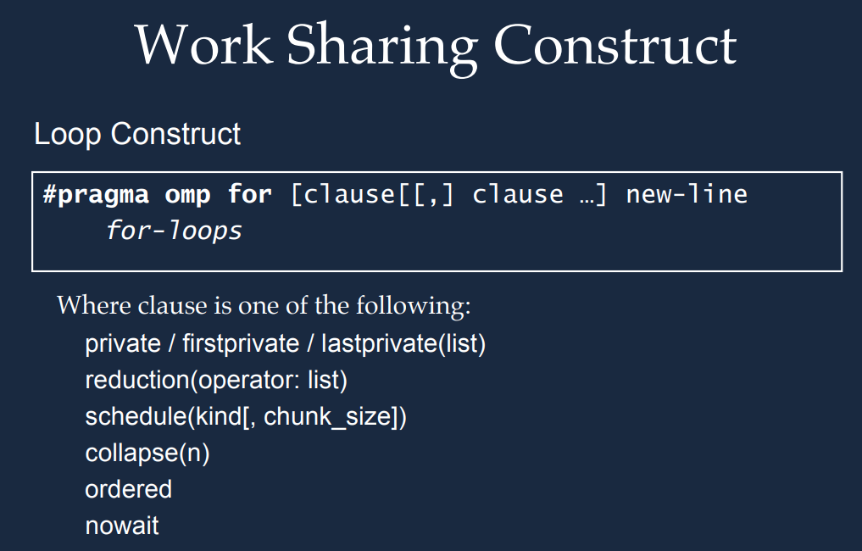

Slide 99
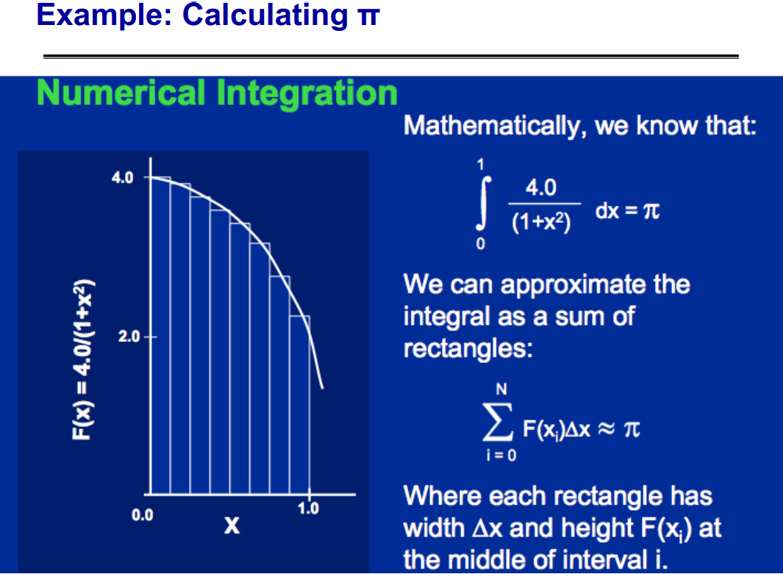

Slide 100
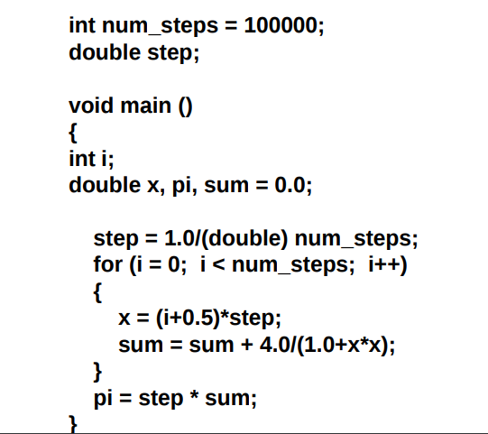

Slide 101
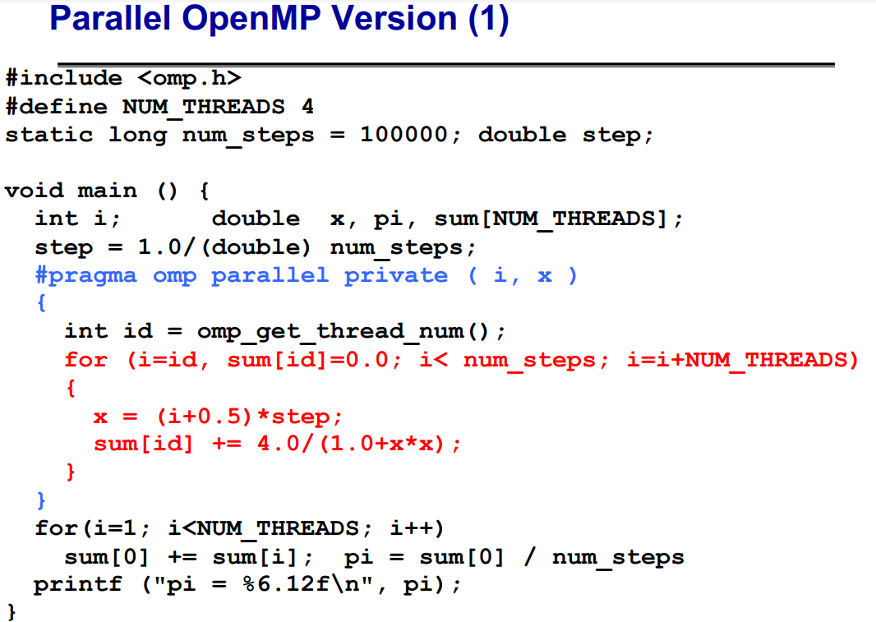

Slide 102
there are two other ways of parallelizing nested loops. First, the two nested for loops can be collapsed in order to be parallelized together using clause collapse(2)
# include <stdio .h>
# include <omp.h>
int main ( int argc , char * argv []) {
int max; sscanf ( argv [1] , "%d", &max );
# pragma omp parallel for collapse (2)
for ( int i = 1; i <= max; i++)
for ( int j = 1; j <= max; j ++)
printf ("%d: (%d ,%d)\n", omp_get_thread_num () , i, j);
return 0;
}

Slide 103
Collapse
clause collapse(2) in line 6 - compiler merges the two nested for loops into one and parallelizes the resulting single loop.
Outer for loop running from 1 to max and max inner for loops running from 1 to max as well, are replaced by a single loop running from 1 to max^2.
All max^2 iterations are divided among available threads together.
As only one loop is parallelized, i.e., the one that comprises iterations of both nested for loops
For instance, if max = 6, all 36 iterations of the collapsed single loop are divided among 4 thread
the work is more evenly distributed among threads.

Slide 104
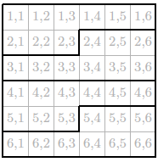
Collapse

Slide 105
other method of parallelizing nested loops is by parallelizing each for loop separately
# include <stdio .h>
# include <omp.h>
int main ( int argc , char * argv []) {
int max; sscanf ( argv [1] , "%d", &max );
# pragma omp parallel for
for ( int i = 1; i <= max; i++) {
# pragma omp parallel for
for ( int j = 1; j <= max; j ++) {
printf ("%d: (%d ,%d)\n", omp_get_thread_num () , i, j);
}
}
return 0;
}

Slide 106
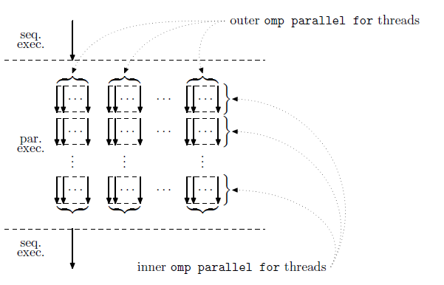
parallelizing each for loop separately

Slide 107
parallelizing each for loop separately
By setting OMP_NUM_THREADS=2,2 and running the program
team of two (outer) threads is established to execute 3 iterations of the outer loop each as they would even if nesting was disabled.
Each iteration of the outer loop must compute one line of the table and thus establishes a team of two (inner) threads to execute 3 iterations of the inner loop each.

Slide 108
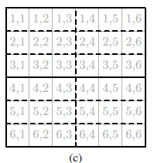
parallelizing each for loop separately

Slide 109
Matrix multiplication
Classical algorithm, based on the definition, encompasses two nested for loops used to compute n^2 independent dot products
double ** mtxMul ( double **c, double **a, double **b, int n) {
# pragma omp parallel for collapse (2)
for ( int i = 0; i < n; i++)
for ( int j = 0; j < n; j++) {
c[i][j] = 0.0;
for ( int k = 0; k < n; k++)
c[i][j] = c[i][j] + a[i][k] * b[k][j];
}
return c;
}

Slide 110
Matrix multiplication
double ** mtxMul ( double **c, double **a, double **b, int n) {
# pragma omp parallel for
for ( int i = 0; i < n; i++)
# pragma omp parallel for
for ( int j = 0; j < n; j++) {
c[i][j] = 0.0;
for ( int k = 0; k < n; k++)
c[i][j] = c[i][j] + a[i][k] * b[k][j];
}
return c;
}

Slide 111
OpenMP: nested parallelism
Nested parallelism is enabled or disabled by setting the shell variable
OMP_NESTED nested
where nested is either true or false.
Within a program, this can be achieved using the following two functions:
void omp_set_nested(int nested) enables or disables nested parallelism;
int omp_get_nested() tells whether nested parallelism is enabled or disabled.
The number of threads at each nested level can be set by calling function
omp_set_num_threads or by setting OMP_NUM_THREADS.

Slide 112
Combining the results of parallel iterations
Most of the time Individual loop iterations aren’t entirely independent as they are used to solve a single problem together
thus each iteration contributes its part to the combined solution.
Most often partial results of different iterations must be combined together
Example
If integers from the given interval are to be added instead of printed out
all subtasks must somehow cooperate to produce the correct sum.

Slide 113
Solution ??????
# include <stdio .h>
int main ( int argc , char * argv []) {
int max; sscanf ( argv [1] , "%d", &max );
int sum = 0;
# pragma omp parallel for
for ( int i = 1; i <= max; i++)
sum = sum + i;
printf ("%d\n", sum );
return 0;
}

Slide 114
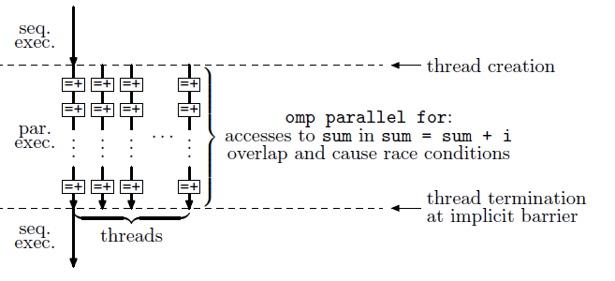
Leads to Race Condition

Slide 115
Combining the results of parallel iterations
This program is run multiple times using several threads, it is very likely that it will not always produce the same result.
In other words, from time to time it will produce the wrong result.
To avoid race conditions
Assignment sum = sum + i can be put inside a critical section
Part of a program that is performed by at most one thread at a time.
This is achieved by the omp critical directive which is applied to the statement or a block immediately following it.

Slide 116
Program using critical sections
# include <stdio .h>
int main ( int argc , char * argv []) {
int max; sscanf ( argv [1] , "%d", &max );
int sum = 0;
# pragma omp parallel for
for ( int i = 1; i <= max; i++)
# pragma omp critical
sum = sum + i;
printf ("%d\n", sum );
return 0;
}

Slide 117
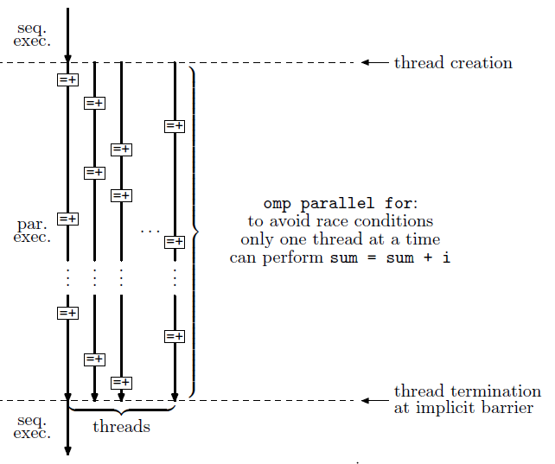

Slide 118
Program using critical sections
Program works correctly because the omp critical directive performs locking around the code it contains,
i.e., the code that accesses variable sum,
thus prevents race conditions.
Use of critical sections in this program makes the program slow because at every moment at most one thread performs the addition and assignment while all other threads are kept waiting

Slide 119
Another way to avoid race conditions is to use atomic access to variables
# include <stdio .h>
int main ( int argc , char * argv []) {
int max; sscanf ( argv [1] , "%d", &max );
int sum = 0;
# pragma omp parallel for
for ( int i = 1; i <= max; i++)
# pragma omp atomic
sum = sum + i;
printf ("%d\n", sum );
return 0;
}

Slide 120
pragma omp atomic
Although sum is a single variable shared by all threads in the team,
Program computes the correct result as the omp atomic directive instructs the compiler to generate code where sum = sum + i update is performed as a single atomic operation
possibly using a hardware supported read-modify-write instructions
Concepts of a critical section and atomic accesses to a variable are very similar
except that an atomic access is much simpler and thus usually faster than a critical section that can contain much more elaborate computation.

Slide 121
OpenMP: critical sections
A critical section is declared as
#pragma omp critical [(name) [hint(hint)]]
structured-block
Structured-block is guaranteed to be executed by a single thread at a time.
Critical section can be given name, an identifier with external linkage so that different tasks can implement their own implementation of the same critical section.
Named critical section can be given a constant integer expression hint to establish a detailed control underlying locking.

Slide 122
OpenMP: atomic access
Atomic access to a variable within expression-stmt is declared as
#pragma omp atomic [seq_cst [,]] atomic-clause [[,] seq_cst]
expression-stmt
or
#pragma omp atomic [seq_cst]
expression-stmt
when update is assumed.
omp atomic directive enforces an exclusive access to a storage location among all threads in the binding thread set without regard to the teams to which the threads belong.

Slide 123
OpenMP: atomic access
Three most important atomic-clauses are the following:
read causes an atomic read of x in statements of the form expr = x;
write causes an atomic write to x in statements of the form x = expr;
update causes an atomic update of x in statements of the form ++x, x++, --x, x--, x = x binop expr, x = expr binop x, x binop= expr.
If seq_cst is used, an implicit flush operation of atomically accessed variable is performed after statement-expr.

Slide 124
To prevent race conditions and to avoid locking or explicit atomic access to variables at the same time, OpenMP provides a special operation called reduction
# include <stdio .h>
int main ( int argc , char * argv []) {
int max; sscanf ( argv [1] , "%d", &max );
int sum = 0;
# pragma omp parallel for reduction (+: sum)
for ( int n = 1; n <= max; n++)
sum = sum + n;
printf ("%d\n", sum );
return 0;
}

Slide 125
clause reduction
Additional clause reduction(+:sum) states that T private variables sum are created, one variable per thread.
The computation within each thread is performed using the private variable sum
only when the parallel for loop has finished are the private variables sum added to variable sum declared in line 5 and printed out in line 9.
The compiler and the OpemMP runtime system perform the final summation of local variables sum in a way suitable for the actual target architecture.

Slide 126
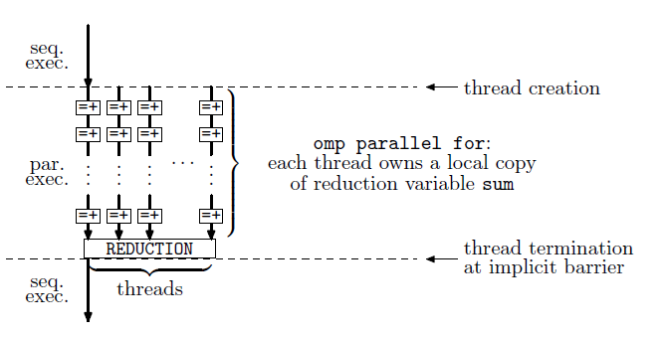

Slide 127
Work Sharing Constructs
Section
Task

Slide 128
Sections
The sections construct is a non-iterative work-sharing construct that contains a set of structured blocks that are to be distributed among and executed by the threads in a team.
Each structured block is executed once by one of the threads in the team in the context of its implicit task.
There is an implicit barrier at the end of a sections construct unless a nowait clause is specified.

Slide 129
Tasks
Tasks are queued and executed whenever possible at the so-called task scheduling points.
Under some conditions, the runtime could be allowed to move task between threads, even in the mid of their lifetime.
Such tasks are called untied and an untied task might start executing in one thread, then at some scheduling point it might be migrated by the runtime to another thread.
Tasks and sections are in many ways similar

Slide 130
// sections
#pragma omp sections
{
#pragma omp section
foo();
#pragma omp section
bar();
}

Slide 131
#pragma omp single nowait
{
#pragma omp task
foo();
#pragma omp task
bar();
}
#pragma omp taskwait

Slide 132
#include<stdio.h>
#include<omp.h>
#include<stdlib.h>
#include<time.h>
int n;
void simple_merge(int a[],int low,int mid,int high);
void merge_sort(int a[],int low,int high)

Slide 133
int main()
{
int a[100],i=0;
double start_time,end_time,val;
printf("\n enter the size of the array elements:");
scanf("%d",&n);
for(i=1;i<=n;i++)
a[i]=rand()%100;
printf("\n array of elements before sorting are:\n");
for(i=1;i<=n;i++)
printf("%d\t",a[i]);
start_time=omp_get_wtime();
merge_sort(a,1,n)
end_time=omp_get_wtime();
val=(end_time-start_time);
printf("\n the time taken to sort the array elements is %f",val);
printf("\n the elements after sorting are:\n");
for(i=1;i<=n;i++)
printf("%d\t",a[i]);
return 0;
}

Slide 134
void simple_merge(int a[],int low,int mid,int high)
{
int i=low,j=mid+1;k=low,c[n];
while(i<=mid && j<=high)
{
if(a[i]<a[j])
{
c[k]=a[i];
i++;
k++;
}
else
{
c[k]=a[j];
j++;
k++;
}
}
while(i<=mid)
c[k+1]=a[i++];
while(j<=high)
c[k++]=a[j++];
for(i=low;i<=high;i++)
a[i]=c[i];
}

Slide 135
void merge_sort(int a[],int low,int high)
{
int mid;
if(low<high)
{
mid=(low+high)/2;
#pragma omp parallel sections
{
#pragma omp section
merge sort(a,low,mid);
#pragma omp section
merge sort(a,mid+1,high);
}
simple_merge(a,low,mid,high);
}
}

Slide 136
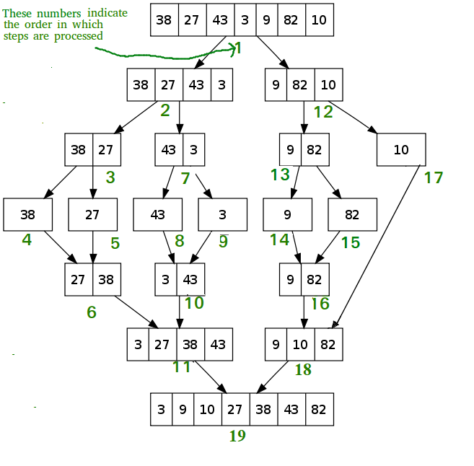

Slide 137
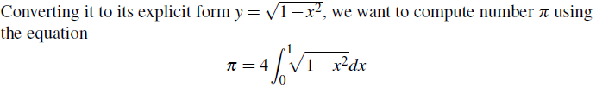
Computing pi by numerical integration
Many problems that require combining results of loop iterations.
Let us start with a numerical integration in one dimension.
Suppose we want to compute number pi by computing the area of the unit circle defined by equation x^2+y^2 = 1.

Slide 138
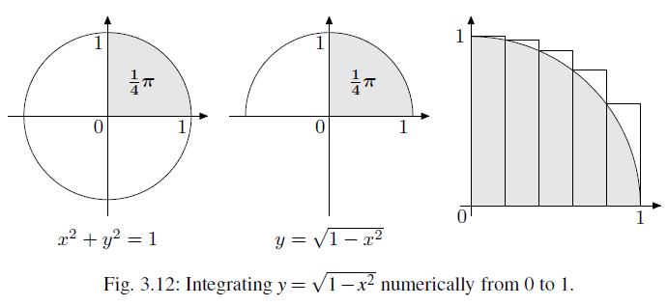

Slide 139
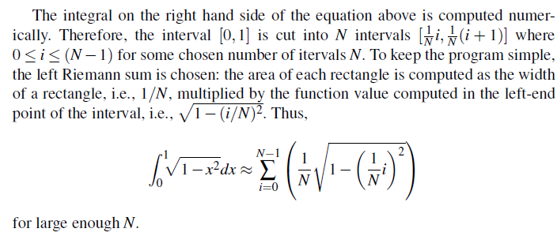

Slide 140
# include <stdio .h>
# include <math .h>
int main ( int argc , char * argv []) {
int intervals ; sscanf ( argv [1] , "%d", & intervals );
double integral = 0.0;
double dx = 1.0 / intervals ;
# pragma omp parallel for reduction (+: integral )
for ( int i = 0; i < intervals ; i ++) {
double x = i * dx;
double fx = sqrt (1.0 - x * x);
integral = integral + fx * dx;
}
double pi = 4 * integral ;
printf (" %20.18 lf\n", pi);
return 0;
}
Unlike intervals, integral, and dx variables x and fx must be thread private.

Slide 141
# include <stdio .h>
# include <math .h>
int main ( int argc , char * argv []) {
int intervals ; sscanf ( argv [1] , "%d", & intervals );
double integral = 0.0;
double x = 0.0;
# pragma omp parallel for reduction (+: integral )
for ( int i = 0; i < intervals ; i ++) {
double fx = sqrt (1.0 - x * x);
integral = integral + fx * dx;
x = x + dx;
}
double pi = 4 * integral ;
printf (" %20.18 lf\n", pi);
return 0;
}

Slide 142
This works well if the program is run by only one thread (set OMP_NUM_THREADS to 1)
but produces the wrong result if multiple threads are used.
The reason is that the iterations are no longer independent:
the value of x is propagated from one iteration to another so the next iteration cannot be performed until the previous has been finished.

Slide 143
Computing p using random shooting
Another way of computing p is to shoot randomly into a square [0;1]X[0;1] and count how many shots hit inside the unit circle and how many do not.
The ratio of hits vs. all shots is an approximation of the area of the unit circle within [0;1]X[0;1].
As each shot is independent of another, shots can be distributed among different threads.

Slide 144


Slide 145
# include <stdio .h>
# include <stdlib .h>
# include <omp.h>
double rnd ( unsigned int * seed ) {
* seed = (1140671485 * (* seed ) + 12820163) % (1 << 24);
return (( double )(* seed )) / (1 << 24);
}

Slide 146
int main ( int argc , char * argv []) {
int num_shots ; sscanf ( argv [1] , "%d", & num_shots );
unsigned int seeds [ omp_get_max_threads () ];
for ( int thread = 0; thread < omp_get_max_threads (); thread ++)
seeds [ thread ] = thread ;
int num_hits = 0;
# pragma omp parallel for reduction (+: num_hits )
for ( int shot = 0; shot < num_shots ; shot ++) {
int thread = omp_get_thread_num ();
double x = rnd (& seeds [ thread ]);
double y = rnd (& seeds [ thread ]);
if (x * x + y * y <= 1) num_hits = num_hits + 1;
}
double pi = 4.0 * ( double ) num_hits / ( double ) num_shots ;
printf (" %20.18 lf\n", pi);
return 0;
}

Slide 147
int main ( int argc , char * argv []) {
int num_shots ; sscanf ( argv [1] , "%d", & num_shots );
int num_hits = 0;
# pragma omp parallel
{
unsigned int seed = omp_get_thread_num ();
# pragma omp for reduction (+: num_hits )
for ( int shot = 0; shot < num_shots ; shot ++) {
double x = rnd (& seed );
double y = rnd (& seed );
if (x * x + y * y <= 1) num_hits = num_hits + 1;
}
}
double pi = 4.0 * ( double ) num_hits / ( double ) num_shots ;
printf (" %20.18 lf\n", pi);
return 0;
}

Slide 148
Distributing iterations among threads
How iterations of a parallel loop, or of a several collapsed parallel loops, are distributed among different threads in a single team of threads.
OpenMP allows the programmer to specify several different iteration scheduling strategies.

Slide 149
# include <stdio .h>
# include <unistd .h>
# include <omp.h>
int main ( int argc , char * argv []) {
int max; sscanf ( argv [1] , "%d", &max );
long int sum = 0;
# pragma omp parallel for reduction (+: sum) schedule ( runtime )
for ( int i = 1; i <= max; i++) {
printf ("%2d @ %d\n", i, omp_get_thread_num ());
sleep (i < 4 ? i + 1 : 1);
sum = sum + i;
}
printf ("%ld\n", sum );
return 0;
}

Slide 150

Distributing iterations among threads
schedule(runtime) clause is added to the omp for directive
It allows the iteration schedule strategy to be defined once the program is started using the shell variable OMP_SCHEDULE.
Each iteration prints out the number of thread that executes it.
Different iterations take different time to execute as specified by the argument of function sleep
If OMP_SCHEDULE=static,
iterations are divided into chunks each containing approximately the same number of iterations and each thread is given at most one chunk.

Slide 151

Distributing iterations among threads

Slide 152



Distributing iterations among threads
If OMP_SCHEDULE=static,1 or OMP_SCHEDULE=static,2
Iterations are divided into chunks containing 1 or 2 iterations, respectively.
Chunks are then assigned to threads in a round-robin fashion

Slide 153

Distributing iterations among threads
If OMP_SCHEDULE=dynamic,1 or OMP_SCHEDULE=dynamic,2,
iterations are divided into chunks containing 1 or 2 iterations, respectively.
Chunks are assigned to threads dynamically:
each thread takes one chunk at a time out of the common pool of chunks, executes it and requests a new chunk until the pool is empty.

Slide 154

Distributing iterations among threads

Slide 155
OpenMP: scheduling parallel loop iterations
Distributing iterations of parallel loops among team threads is controlled by the schedule clause.
schedule(static): The iterations are divided into chunks each containing approximately the same number of iterations and each thread is given at most one chunk.
schedule(static,chunk_size): The iterations are divided into chunks where each chunk contains chunk_size iterations. Chunks are then assigned to threads in a round-robin fashion.

Slide 156
OpenMP: scheduling parallel loop iterations
schedule(dynamic,chunk_size): The iterations are divided into chunks where each chunk contains chunk_size iterations. Chunks are assigned to threads dynamically: each thread takes one chunk at a time out of the common pool of chunks, executes it and requests a new chunk until the pool is empty.
schedule(auto): The selection of the scheduling strategy is left to the compiler and the runtime system.
schedule(runtime): The scheduling strategy is specified at run time using the shell variable OMP_SCHEDULE.

Slide 157
The details of parallel loops and reductions
The parallel for loop and reduction operation are so important in OpenMP programming that they should be studied and understood in detail.
Let’s return to the program for computing the sum of integers from 1 to max as shown in Listing 3.14.
If it assumed that T, the number of threads, divides max and the static iteratin scheduling strategy is used,

Slide 158
# include <stdio .h>
# include <omp.h>
int main ( int argc , char * argv []) {
int max; sscanf ( argv [1] , "%d", &max );
int ts = omp_get_max_threads ();
if ( max % ts != 0) return 1;
int sums [ts ];
# pragma omp parallel
{
int t = omp_get_thread_num ();
int lo = (max / ts) * (t + 0) + 1;
int hi = (max / ts) * (t + 1) + 0;
sums [t] = 0;
for ( int i = lo; i <= hi; i ++)
sums [t] = sums [t] + i;
}
int sum = 0;
for ( int t = 0; t < ts; t++) sum = sum + sums [t];
printf ("%d\n", sum );
return 0;
}

Slide 159

The details of parallel loops and reductions

Slide 160
Parallel tasks
Although most parallel programs spend most of their time running parallel loops, this is not always the case.
Hence, it is worth exploring how a program consisting of different tasks can be parallelized.

Slide 161
Running independent tasks in parallel
Consider computing the sum of integers from 1 to max one more time.
Interval from 1 to max is split into a number of mutually disjoint subintervals.
For each subinterval a task that first computes the sum of all integers of a subinterval and then adds the sum of the subinterval to the global sum, is used.

Slide 162

#pragma omp single

Slide 163


Slide 164


Slide 165


Slide 166


Slide 167


Slide 168
1 # include <stdio .h>
2 # include <omp.h>
3
4 int main ( int argc , char * argv []) {
5 int max; sscanf ( argv [1] , "%d", &max );
6 int tasks ; sscanf ( argv [2] , "%d", & tasks );
7 if ( max % tasks != 0) return 1;
8 int sum = 0;
9 # pragma omp parallel
10 {
11 # pragma omp single
12 for ( int t = 0; t < tasks ; t ++) {
13 # pragma omp task
14 {
15 int local_sum = 0;
16 int lo = (max / tasks ) * (t + 0) + 1;
17 int hi = (max / tasks ) * (t + 1) + 0;
18 // printf ("% d: %d ..% d\n", omp_get_thread_num () , lo , hi);
19 for ( int i = lo; i <= hi; i ++)
20 local_sum = local_sum + i;
21 # pragma omp atomic
22 sum = sum + local_sum ;
23 }
24 }
25 }
26 printf ("%d\n", sum );
27 return 0;
28 }

Slide 169
Running independent tasks in parallel
Computing the sum is performed in the parallel block in lines 9–25.
For loop in line 12 creates all T tasks where each task is defined by the code in lines 13–23.
Once the tasks are created, it is more or less up to OpenMP’s runtime system to schedule tasks and execute them.
For loop in line 12 is executed by only one thread as otherwise each thread would create its own set of T tasks.
This is achieved by placing the for loop in line 12 under the OpenMP directive single.
The OpenMP directive task in line 13 specifies that the code in lines 14–23 is to be executed as a single task.
The local sum is initialized to 0 and the subinterval bounds are computed from the task number, i.e., t.
The integers of the subinterval are added up and the local sum is added to the global sum using atomic section to prevent a race condition between two different tasks.

Slide 170
Fibonacci numbers
1 # include <stdio .h>
2 # include <omp.h>
3
4 long fib (int n) { return (n < 2 ? 1 : fib (n - 1) + fib (n - 2)); }
5
6 int main ( int argc , char * argv []) {
7 int max; sscanf ( argv [1] , "%d", &max );
8 # pragma omp parallel
9 # pragma omp single
10 for ( int n = 1; n <= max; n ++)
11 # pragma omp task
12 printf ("%d: %d %ld\n", omp_get_thread_num () , n, fib (n));
13 return 0;
14 }

Slide 171
OpenMP: tasks
Task is declared using the directive
#pragma omp task [clause [[,] clause] . . . ]
structured-block
Task directive creates a new task that executes structured-block.
New task can be executed immediately or can be deferred.
A deferred task can be later executed by any thread in the team.

Slide 172
OpenMP: tasks
The task directive can be further refined by a number of clauses, the most important being the following ones:
final(scalar-logical-expression) causes, if scalar-logical-expression evaluates to true, that the created task does not generate any new tasks any more,
i.e., the code of would-be-generated new subtasks is included in and thus executed within this task;
if([task:] scalar-logical-expression) causes, if scalar-logical-expression evaluates to false, that an undeterred task is created
i.e., the created task suspends the creating task until the created task is finished.

Slide 173
OpenMP: limiting execution to a single thread
Within a parallel section, the directive
#pragma omp single [clause [[,] clause] . . . ]
structured-block
causes structured-block to be executed by exactly one thread in a team (not necessarily the master thread).
If not specified otherwise, all other threads wait idle at the implicit barrier at the end of the single directive.

Slide 174
OpenMP: limiting execution to a single thread
The most important clauses are the following:
private(list) specifies that each variable in the list is private to the code executed within the single directive;
nowait removes the implicit barrier at the end of the single directive and thus allows other threads in the team to proceed without waiting for the code under the single directive to finish.

Slide 175
Quicksort
1 void par_qsort ( char ** data , int lo , int hi ,
2 int (* compare )( const char *, const char *)) {
3 if (lo > hi) return ;
4 int l = lo;
5 int h = hi;
6 char *p = data [( hi + lo) / 2];
7 while (l <= h) {
8 while ( compare ( data [l], p) < 0) l ++;
9 while ( compare ( data [h], p) > 0) h --;
10 if (l <= h) {
11 char *tmp = data [l]; data [l] = data [h]; data [h] = tmp ;
12 l++; h --;
13 }
14 }
15 # pragma omp task final (h - lo < 1000)
16 par_qsort (data , lo , h, compare );
17 # pragma omp task final (hi - l < 1000)
18 par_qsort (data , l, hi , compare );
19

Slide 176
Quicksort
The recursive calls are modified because they can be performed independently, i.e., at the same time.
Each of the two recursive calls is therefore executed as its own task.
Creating a new task only makes sense if a part of the table that must be sorted using a recursive call is big enough.
clause final in lines 15 and 17 is used to prevent creating new tasks for parts of table that contain less that 1000 elements.

Slide 177
call of the parallel implementation of the Quicksort algorithm.
1 # pragma omp parallel
2 # pragma omp single
3 par_qsort ( strings , 0, num_strings - 1, compare );

Slide 178

comparison of the running time of the sequential and parallel version of the Quicksort algorithm when sorting n random strings of max length 64 using a quad-core processor with multithreading

Slide 179
Combining the results of parallel tasks
1 int par_qsort ( char ** data , int lo , int hi ,
2 int (* compare )( const char *, const char *)) {
3 if (lo > hi) return 0;
4 int l = lo;
5 int h = hi;
6 char *p = data [( hi + lo) / 2];
7 int count = 0;
8 while (l <= h) {
9 while ( compare ( data [l], p) < 0) l ++;
10 while ( compare ( data [h], p) > 0) h --;
11 if (l <= h) {
12 count ++;
13 char *tmp = data [l]; data [l] = data [h]; data [h] = tmp ;
14 l++; h --;
15 }
16 }

Slide 180
Combining the results of parallel tasks
17 int locount , hicount ;
18 # pragma omp task shared ( locount ) final (h - lo < 1000)
19 locount = par_qsort (data , lo , h, compare );
20 # pragma omp task shared ( hicount ) final (hi - l < 1000)
21 hicount = par_qsort (data , l, hi , compare );
22 # pragma omp taskwait
23 return count + locount + hicount ;
24 }

Slide 181
Quicksort algorithm
Quicksort algorithm returns the number of element pairs swapped during the partition phases.
three new variables can be introduced, namely count, locount and hicount, that contain the number of swaps in the current partition phase
total numbers of swaps in recursive calls
values of variables locount and hicount are set in two newly created tasks and must therefore be shared among the creating and the created tasks.
This is achieved using shared clause

Slide 182
Quicksort algorithm
To prevent it from computing the sum of all three counters and returning the result when variables locount and hicount might not have been set yet
taskwait directive is used.
It represents an explicit barrier:

Slide 183
OpenMP: explicit task barrier
An explicit task barrier is created by the following directive:
#pragma omp taskwait
It specifies a point in the program the task waits until all its subtasks are finished.

Slide 184
Thankyou

